Slide 1

Copyright 2010 Davitily

Slide 2
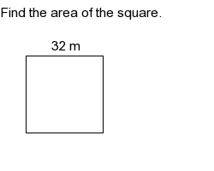
Finding the Area of a Square
Step 1:
Find the length of the sides.
Step 2:
Substitute and multiply.
Step 3:
Write the units.
Step 1:
The length of
each side is 32
Step 2:
Substitute and
multiply
Area = side x side
Area = 32 x 32
Area = 1,024
Step 3:
Write the units

Slide 3
For more practice, visit
www.mathproblemgenerator.com

